Slide 1
Hadoop

Slide 2
Outline
RDBMS Problems
Distributed File System…
Tradeoffs of DFS
HDFS Architecture
YARN Overview
Hands-On
Map Reduce Framework
Hands-On -- 2

Slide 3
Traditional Databases…
Provides data to be stored in tables
Persists data in the form of rows and columns
Provides facility primary key, to uniquely identify the rows
Creates indexes for quicker data retrieval
Sharing a common column in two or more tables(primary key and foreign key)
Provides multi user accessibility that can be controlled by individual users.

Slide 4
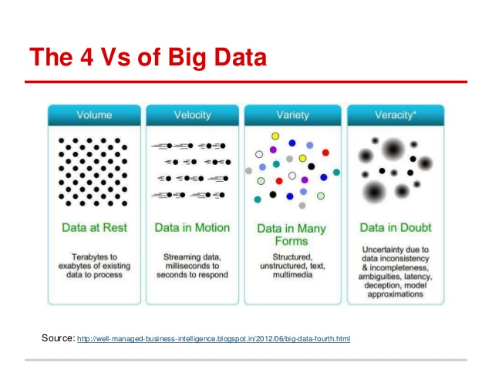

Slide 5
RDBMS Problems
Volume :
Media.net processes 4.5+ billion events each day
RDBMS finds it challenging to handle such huge data volumes.
Variety :
RDBMSs have inflexible schemas
RDBMS cannot handle unstructured data.They’re designed and structured to accommodate structured data
Big Data primarily comprises semi-structured data
Velocity :
RDBMS lacks in high velocity because it’s designed for steady data retention rather than rapid growth

Slide 6


Slide 7
Hadoop
Hadoop is an open-source software framework for storing data and running applications on clusters of commodity hardware.
It provides massive storage for any kind of data, enormous processing power and the ability to handle many concurrent tasks or jobs.

Slide 8
Distributed File System
A file system is responsible for the organization, storage, retrieval of files
The file system is responsible for controlling access to the data and for performing low-level operations such as buffering frequently-used data and issuing disk I/O requests
Our goal is to design a distributed file system

Slide 9
Design DFS
How to distribute the data?
How to keep track of the blocks of a file?
How to make it fault tolerant?
Write process
Read process
High availability of namenode
How to tolerate downtime of server which is holding the data?

Slide 10
Tradeoffs of DFS
Weaker ACID properties – BASE Properties
basically available, soft state, eventually consistent
CAP Theorem
Consistency.
The client perceives that a set of operations has occurred all at once.
Availability.
Every operation must terminate in an intended response.
Partition tolerance.
Operations will complete, even if individual components are unavailable.
Notes:
https://www.linkedin.com/pulse/hadoop-vs-rdbms-thiensi-le

Slide 11
HDFS -- Features
Highly fault-tolerant
High throughput
Suitable for applications with large data sets
Streaming access to file system data
Can be built out of commodity hardware

Slide 12
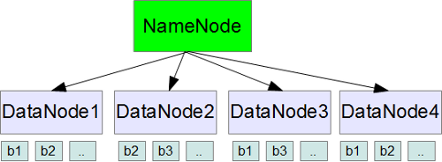
HDFS Architecture

Slide 13
HDFS Write Operation

Slide 14
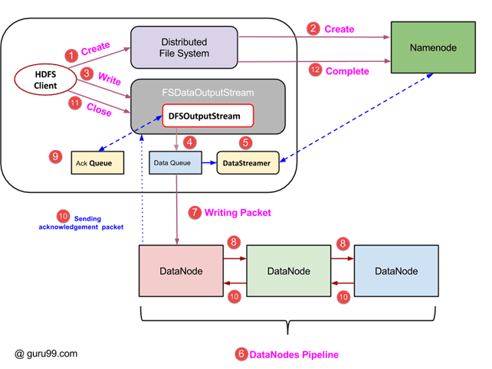

Slide 15
Steps
Steps for hdfs write

Slide 16
HDFS Read Operation

Slide 17
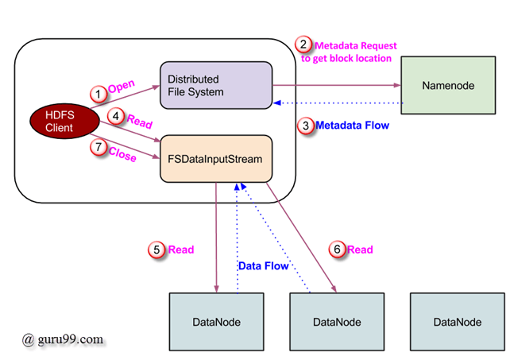

Slide 18
Steps
Steps for hdfs read

Slide 19
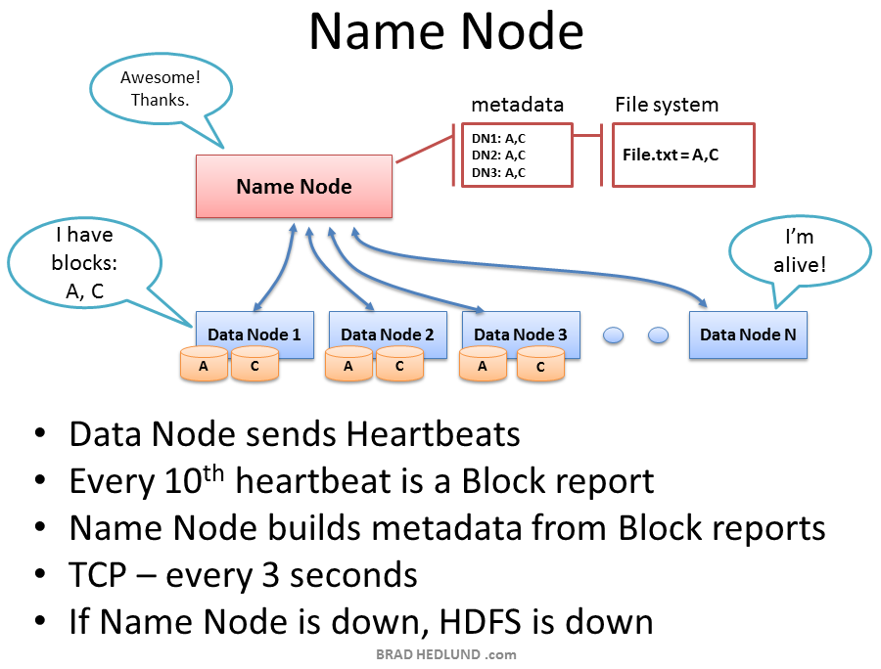

Slide 20
HDFS Blocks
Hadoop distributed file system also stores the data in terms of blocks. However the block size in HDFS is very large.
The default size of HDFS block is 64MB. The files are split into 64MB blocks and then stored into the hadoop filesystem.

Slide 21
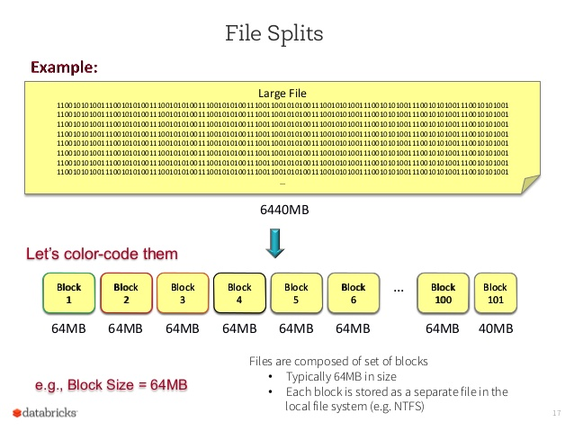

Slide 22
HDFS commands
hadoop fs -ls <filepath>
hadoop fs -cat <filepath>
hadoop fs -du -h <filepath>
hadoop fs -du -s -h <filepath>
hadoop fs -copyFromLocal <localsrc> <hdfs_path>
hadoop fs -copyToLocal <hdfs_path> <local_path>
hadoop fs -mkdir <dir_path>
hadoop fs -touchz <filepath>

Slide 23
Problem Statement 1
Write a program to count the number of occurrences of each word in the file

Slide 24
MAP REDUCE

Slide 25
Map Reduce Framework
framework for easily writing applications which process vast amounts of data (multi-terabyte data-sets) in-parallel on large clusters (thousands of nodes) of commodity hardware in a reliable, fault-tolerant manner
A method for distributing computation across multiple nodes

Slide 26
Each node processes the data that is stored at that node
Consists of two main phases
Map
Reduce

Slide 27
Map Function
Reads data and breaks into key-value pairs
Outputs zero or more key/value pairs

Slide 28
Shuffle and Sort
Output from the mapper is sorted by key
All values with the same key are guaranteed to go to the same machine

Slide 29
Reduce Function
Called once for each unique key
Gets a list of all values associated with a key as input
The reducer outputs zero or more final key/value pairs
Usually just one output per input key

Slide 30
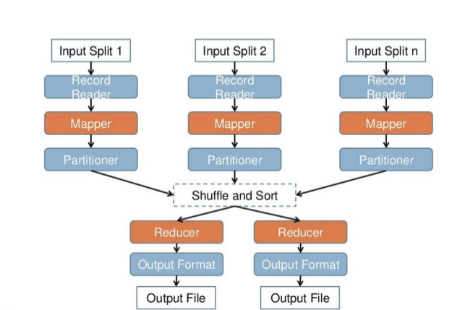

Slide 31
Problem Statement 2
Write a program to count the number of occurrences of each word in the file

Slide 32
Word Count Example

Slide 33
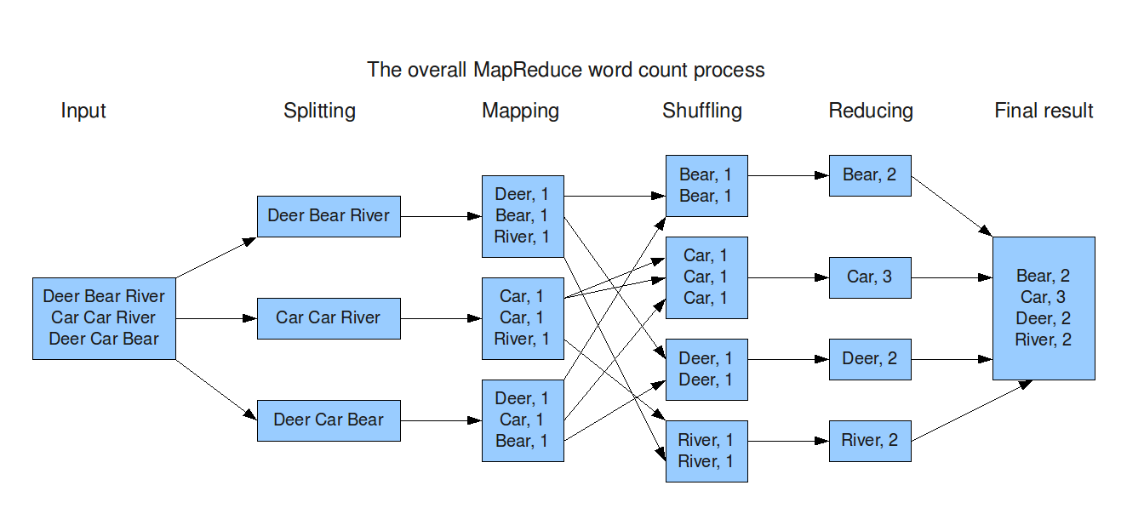

Slide 34
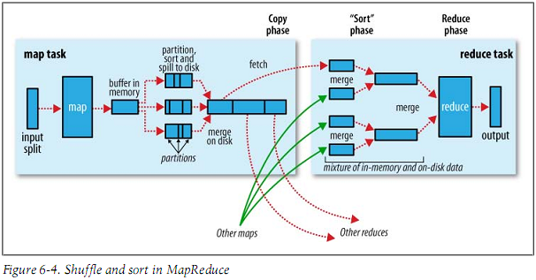
Mapreduce Internals

Slide 35
YARN

Slide 36
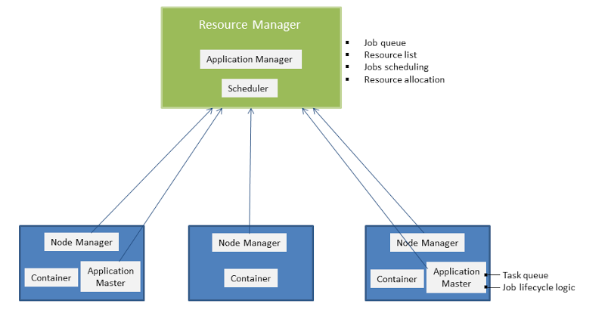
YARN(Yet Another Resource Negotiator)

Slide 37
YARN Components
Scheduler:
responsible for allocating resources to the various running applications
it performs no monitoring or tracking of status for the application
it offers no guarantees about restarting failed tasks either due to application failure or hardware failures
The current schedulers such as the CapacityScheduler and theFairScheduler
Application Manager:
responsible for accepting job-submissions
Responsible for negotiating the first container for executing the application specific ApplicationMaster
provides the service for restarting the ApplicationMaster container on failure

Slide 38
NodeManager is the per-machine framework agent who is responsible for containers, monitoring their resource usage (cpu, memory, disk, network) and reporting the same to the ResourceManager/Scheduler.
Application Master:
The Application Master is itself a container, albeit a special one, sometimes called container 0
responsible for launching subsequent containers as required by the job
Handling of failure of containers and application master:
The Application Manager handles failures of the Application Master
Application Master handles failures of job containers

Slide 39
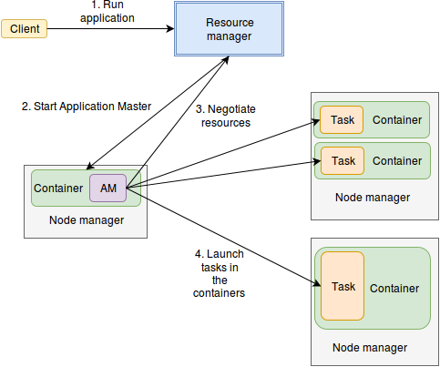

Slide 40
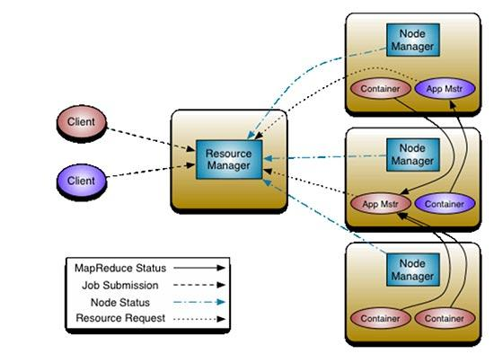

Slide 41
Schedulers

Slide 42
Schedulers
Capacity scheduler:
The CapacityScheduler is designed to allow sharing a large cluster while giving each organization a minimum capacity guarantee.
The central idea is that the available resources in the Hadoop Map-Reduce cluster are partitioned among multiple organizations who collectively fund the cluster based on computing needs
There is an added benefit that an organization can access any excess capacity no being used by others. This provides elasticity for the organizations in a cost-effective manner.

Slide 43
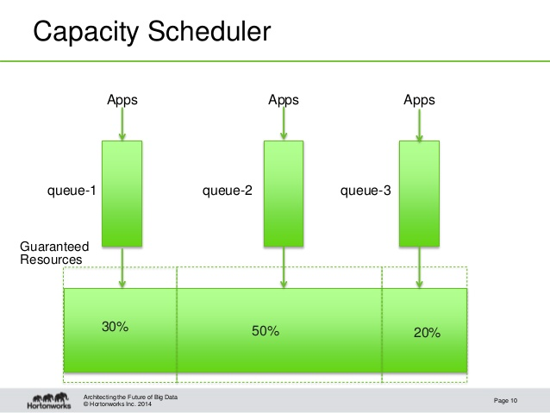

Slide 44
Schedulers
Fair Share Scheduler:
Fair scheduling is a method of assigning resources to jobs such that all jobs get, on average, an equal share of resources over time
When there is a single job running, that job uses the entire cluster. When other jobs are submitted, tasks slots that free up are assigned to the new jobs, so that each job gets roughly the same amount of CPU time
Unlike the default Hadoop scheduler, which forms a queue of jobs, this lets short jobs finish in reasonable time while not starving long jobs

Slide 45
It is also a reasonable way to share a cluster between a number of users.
Finally, fair sharing can also work with job priorities - the priorities are used as weights to determine the fraction of total compute time that each job should get.

